Slide 1
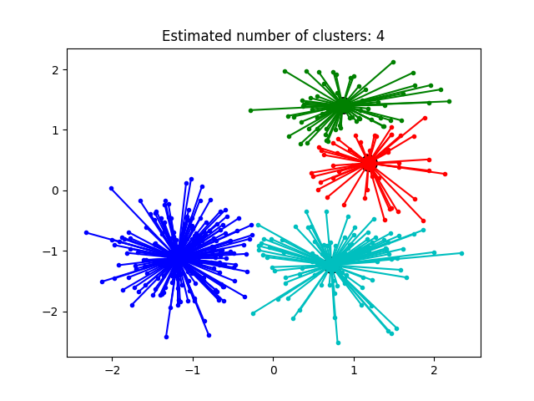
Affinity Propagation, instead, takes as input measures of similarity between pairs of data points, and simultaneously considers all data points as potential exemplars. Real-valued messages are exchanged between data points until a high-quality set of exemplars and corresponding clusters gradually emerges.

Slide 2
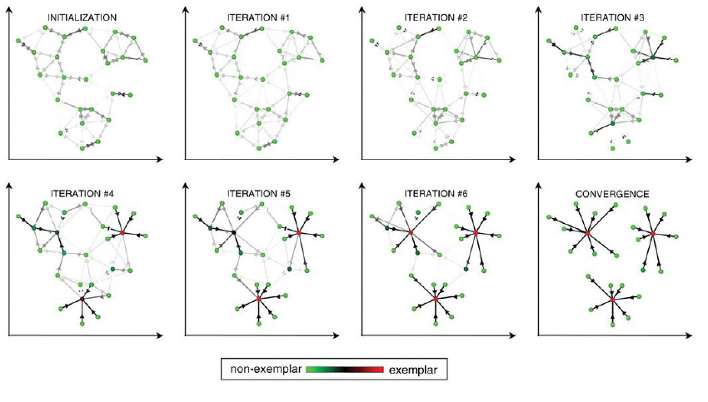
Illustration of how affinity propagation works

Slide 3
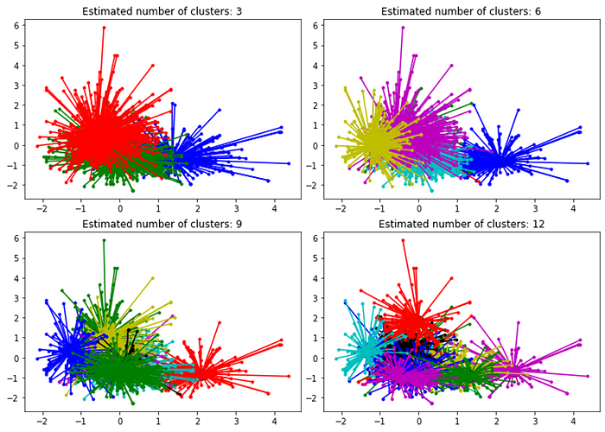
The Affinity Propagation algorithm starts by considering datapoints that can be exemplars to form clusters. All datapoints are candidates to be ‘exemplar datapoints’.
All ‘exemplar datapoints’ are compared to other datapoints, called ‘target datapoints’, to find how similar they are.
The ‘target datapoints’ return to ‘exemplar datapoints’ if they are still available to associate.
Otherwise, the ‘target datapoints’ may have already been associated with other ‘exemplar datapoints’ with who they have higher affinity.
The ‘exemplar datapoints’ respond to ‘target datapoints’ with an updated similarity.
This dance continues until all datapoints are integrated into a cluster.

